Slide 1

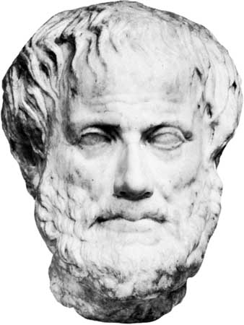
Debate Team Project Review “It is the mark of an educated mind to be able to entertain a thought without accepting it.” Aristotle
Developers:
Allen Lyons, Adrian Smiltz , Derek Johnson, and Lucas Stroud
February 2018

Slide 2




Agenda
Focus of Debate Team App
High Level Description
Development Process
Demonstration
Planned Improvements

Slide 3
Why Build a New Debating Site?

Slide 4



ETHOS LOGOS PATHOS
Focus
The Yea or Nay format keeps debate on focus
Free Thinking
Style
A site focused on refining the argument, not creating divisions.
A format and database that simplifies the visual experience

Slide 5
Team Efforts
Database, ORM Model Setup, and front end Java Script
Allen
Authentication using Passport-JWT and bcrypt primarily
Adrian
Overall idea and SCRUM Master
Lucus
Derek
Front End Java Script, HTML , and Styling

Slide 6
High Level Description
Formatting is dynamic and based on a friendly Greek style
Login requires a password and authorizes the user to view, create and add to debates
Each debate stores the user info and argument into mySQL
The debate has live interaction

Slide 7
Demo

Slide 8
Planned Improvements
Deliverables | Description
Point System | Create a way for users to give strong arguments points. Users already agreeing will be able to award 1 point, while opposing users can award 5 points for arguments they may not agree with, but appreciate
Word filter | An automatic filtering of words not deemed permissible my the admin
Profile info | Given a user a page to review their posts, points and create person info if they like.

Slide 9
Questions and Answers

Slide 10
Thank you!

